Slide 1
Fundamentals of Flight
A Basic Introduction to Aerodynamics
Notes:
This presentation as I go through it today may seem somewhat disjointed so let me explain what’s going on. I’ve posted this presentation on our website so all of you can access it. It’s a ‘slide bank’ more than one cohesive presentation I wanted to make it useful to you regardless of the grade level you’re teaching. So what you’ll see today is a mix of slides from different sources with different levels of explanation. You can pick and choose what will work for you in your classroom. I’ve also included notes on most slides. Some is scripting and there are also leads to website for more information or more illustrations.
These first two slides are a good example – two different explanations of the same thing, each of which can stand alone in the presentation. Delete or hide the one you don’t want to use.

Slide 2
Course Objectives
Introduction.
Be familiar with aircraft components.
The flight theory [basic principals]
Forces and constraints affecting the flight.
Aircraft flight controls.

Slide 3
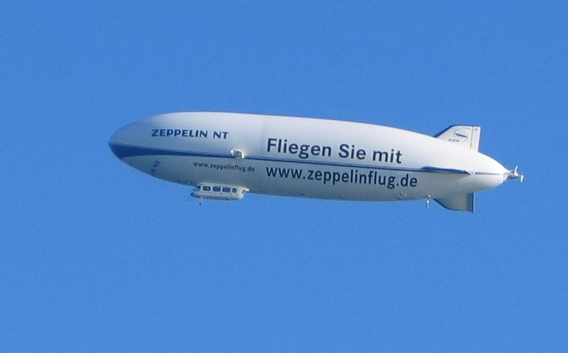
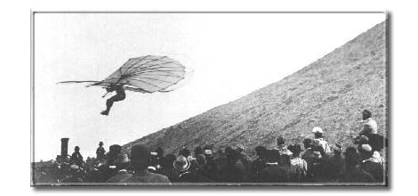
Aircrafts
An aircraft is a flying vehicle called a heavier than air vehicle. It needs a source of power without which it won’t be able to fly and it becomes like a stone in the air.
A lighter than air vehicle doesn’t need a source of power to fly such as balloons and air ships.
Montgolfier brothers in Annonay, France in 1783

Slide 4
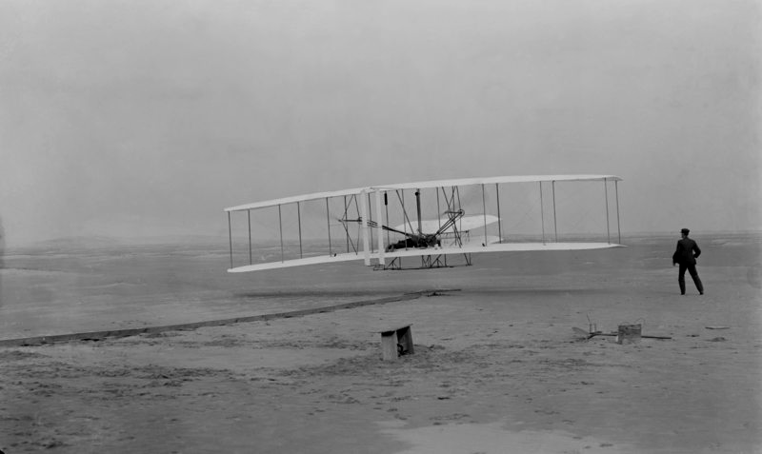
History of flight
In 17 December 1903, the Wright brothers have made the first successful flight for a heavier than air aircraft.
They flew in the air for a distance of 852 feet [290m.] in 59 seconds. It was the first heavier-than-air, powered aircraft to make a sustained, controlled flight with a pilot aboard.

Slide 5
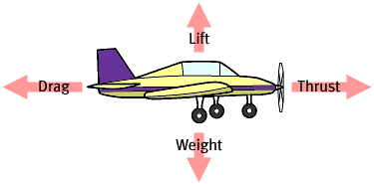
The Four Forces of Flight
The four forces act on the airplane in flight and also work against each other.
Notes:
Since the Wright brothers first flew in 1903, people have created a multitude of airplane types. But every one of them has dealt with the same four forces--lift, weight, thrust, and drag.
Lift is the hardest to understand, so let’s tackle it first.
We used a query response (I say “lift” you say “weight”, I say “thrust” you say “drag”) of the four forces to get the kids settled when we taught the Aviation Immersion to 3rd, 4th and 5th graders at Cherry Creek Challenge School.
Picture from: Plane Math http://www.planemath.com/activities/pmenterprises/forces/forces2.html (See Internet Resources Guide)

Slide 6
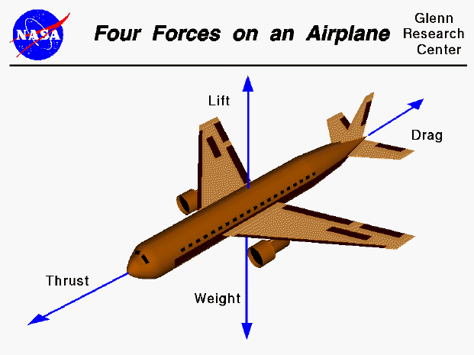
The Four Forces of Flight
The four forces act on the airplane in flight and also work against each other.
Notes:
Since the Wright brothers first flew in 1903, people have created a multitude of airplane types. But every one of them has dealt with the same four forces--lift, weight, thrust, and drag.
Lift is the most complex, so let’s tackle it first.
Picture from: http://www.grc.nasa.gov/WWW/K-12/ (See Internet Resources Guide)

Slide 7
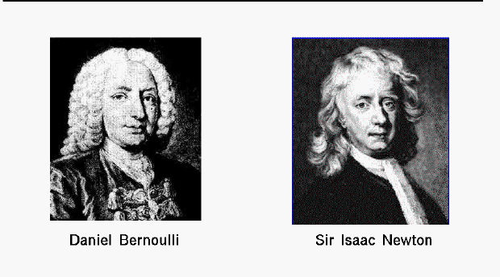
What’s it take to create lift?
Air and motion.
How do we explain lift?
Newton’s Laws of Motion and Bernoulli’s Principal are used to explain lift.
Notes:
You need a fluid (air acts like a fluid) and motion. You need air and you need the wing to be moving through the air (or air to be moving over the wing).
***So, if the lift off speed of a small aircraft is 50 kts, will it try to fly in a strong wind? You bet it will – that’s why we always tie airplanes down!
Laws/principals proposed by Bernoulli & Newton are used to explain lift. (although neither of them proposed the theories for that reason)

Slide 8
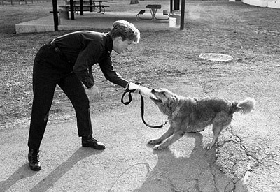
Newton's Third Law of Motion
Newton’s Third Law states that for every action there is an equal and opposite reaction.
Notes:
Illustration from Plane Math: http://www.planemath.com/ (See Internet Resources)

Slide 9
Newton's 3rd law (F = -F)
If a plane flies at constant speed, it stays in the air due to Newton's 3rd law.
The direct pressure of the air pushing on the bottom of the wing keeps the plane
in the air. In other words, as the wing pushes down on the air, the air pushes up
with an equal and opposite force. Newton's 3rd law states that forces always come
in equal and opposite pairs. For instance, if you push on a wall, the wall pushes
back with the same amount of force. Newton's 3rd law always governs during the
flight of a plane

Slide 10
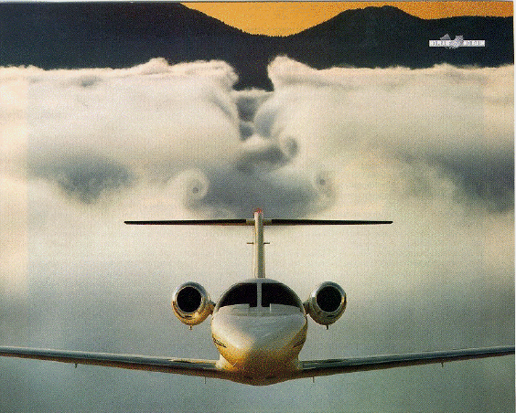

Slide 11
Bernoulli's Principle
where: P = pressure (force exerted divided by area exerted on)
rho = density of the fluid V = velocity of the moving object or fluid
where: P = pressure V = velocity A = cross sectional area of flow

Slide 12
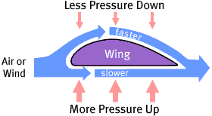
Bernoulli's Principle: slower moving air below the wing creates greater pressure and pushes up.
Notes:
We’ve covered how Newton’s Laws of Motion are used to explain lift. Let’s talk now about how Bernoulli’s Principle helps.
The air above a wing tends to move faster than the air below it. According to Bernoulli's Principle, slower air has higher pressure than faster air. That means that the air pressure pushing up on the bottom of the wing is greater than the pressure pushing down, so the wing goes up.

Slide 13
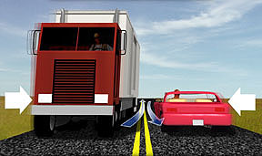
Bernoulli’s Theory in Action
Air speeds up in the constricted space between the car & truck creating a low-pressure area. Higher pressure on the other outside pushes them together.
Notes:
The sideward tug you feel on your car when you pass a large truck going in the opposite direction is caused by air pressure. The passing vehicles form a constriction that speeds up the flow of air, reducing the air pressure between them. (It makes no difference which is moving--the air or the vehicles. The result is the same.) The higher air pressure on the other side of the car pushes it toward the truck during the split-second as they pass.

Slide 14
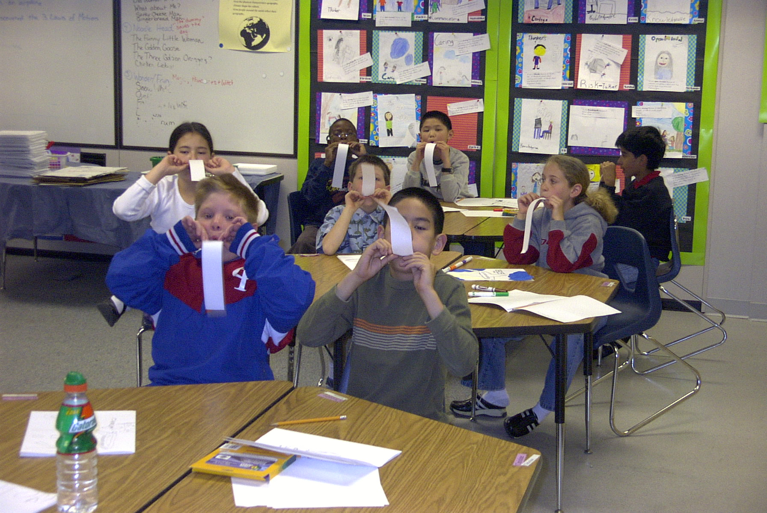
Notes:
One of the many simple illustrations of Bernoulli’s Principle. Here a couple more follow.

Slide 15
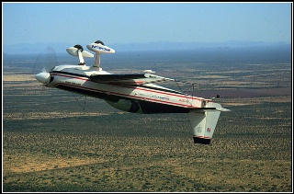
How can an airplane fly upside down?
Notes:
Answering “how do airplanes fly inverted” is difficult if you stick only with the ‘curve over the top of the wing makes the air move faster” explanation. The curve (or camber) of many wings is greater on the top and facilitates the pressure difference between top and bottom. However, with no camber difference between top and bottom or even with no curve at all in the wing, pressure difference can be created by tilting the wing into the airflow – angle of attack.
As long as the wing is tilted into the oncoming airflow (relative wind) at a great enough angle, the wing will produce lift. It doesn't matter which surface of the wing-- top or bottom--is facing "up." Aerobatic airplanes, which are built to fly upside down, have wings whose upper and lower surfaces are equally curved. Wings shaped this way make it easier to fly upside down because they don't need to be tilted as far to produce enough lift.

Slide 16
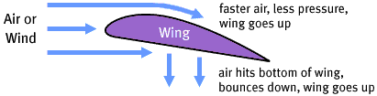
A wing creates lift due to a combination of Bernoulli’s Principal & Newton’s Third Law
Notes:
The super-simple explanation!

Slide 17


Aircraft Components
Wings and Airfoils
The wing is responsible of producing the necessary lift force for an aircraft.
An airfoil is the cross-section of an aircraft wing, and it has a shape with aerodynamic properties.

Slide 18
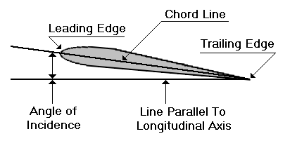


Aircraft Components
Airfoil Parameters
Leading edge
Trailing edge
Camber line
Chord line
Airfoil thickness distribution
Airfoil maximum thickness and camber
Symmetric airfoil
Cambered airfoil

Slide 19
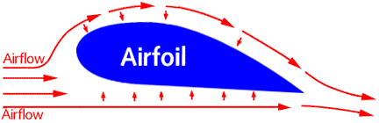
Applications over airfoils
An important application of the Bernoulli’s principal is made in giving lift to the wing of an airplane, an airfoil.
The airfoil is designed to increase the velocity of the airflow above its surface, thereby decreasing pressure above the airfoil. Simultaneously, the impact of the air on the lower surface of the airfoil increases the pressure below. This combination of pressure decrease above and increase below produces lift.

Slide 20
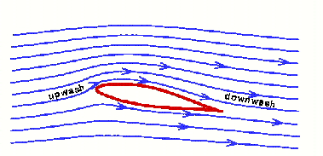
Applications over airfoils
In order to generate lift, a wing must do the action in the air while lift is the reaction [Newton’s 3rd law].
For more lift the wing can either divert more air (mass) or increase its downward velocity. This downward velocity behind the wing is called "downwash" [Newton’s 2nd law].

Slide 21
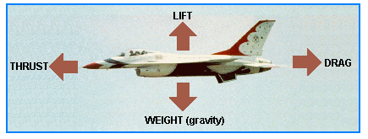
Basic Forces Acting On An Aircraft
There are 4 basic forces acting on an aircraft while flying in the air.
Thrust
Drag
Lift
Weight (gravity)

Slide 22
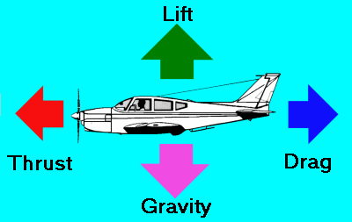
Basic Forces Acting on an aircraft
Thrust and lift are artificially created forces used to overcome the forces of nature and enable an airplane to fly.
Lift opposes Weight
Thrust opposes Drag
The engine is designed to produce thrust to overcome drag.
The wing is designed to produce lift to overcome the weight (gravity).

Slide 23
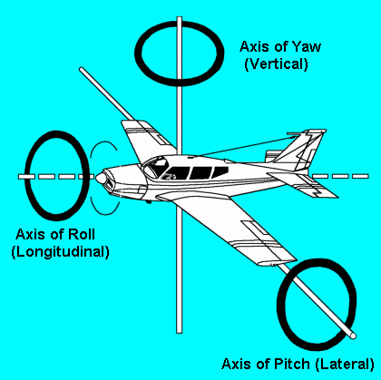
Flight Directions and Controls
Longitudinal Axis: Motion about it is roll and is produced by movement of the ailerons located at the trailing edges of the wings.
Lateral Axis: Motion about it is pitch and is produced by movement of the elevators at the rear of the horizontal tail assembly.
Vertical Axis: Motion about it is yaw and is produced by movement of the rudder located at the rear of the vertical tail assembly.

Slide 24
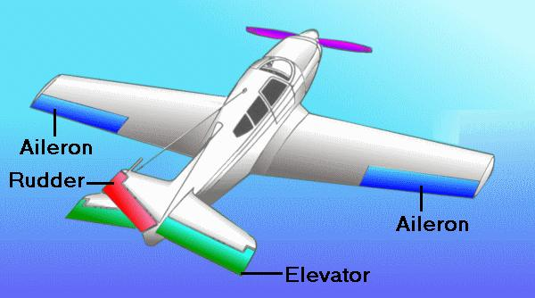
Primary Flight Control Surfaces
Ailerons → roll function
Trimmable horizontal stabilizer → pitch function (large movement)
Elevator → pitch function (small movement)
Rudder → yaw function
Roll spoilers → helps in the roll function at low speeds

Slide 25
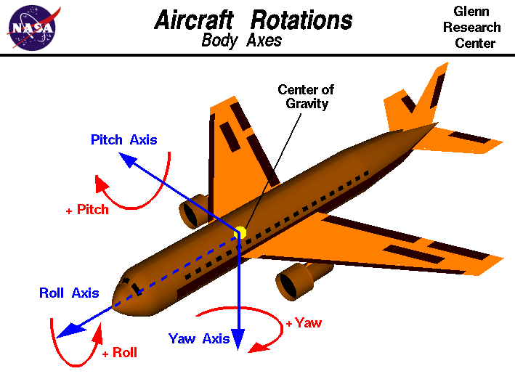
Flight Control Surfaces And Rotations

Slide 26
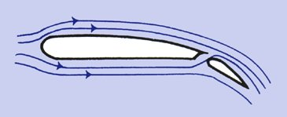
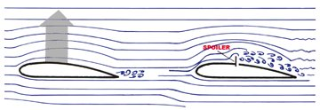
Secondary Flight Control Surfaces
Flaps → increase lift of the wing.
Slats → delays the flow separation over the airfoil.
Outer and inner speed brakes (spoilers) → decrease the aircraft speed by spoiling the lift over the wing.

Slide 27
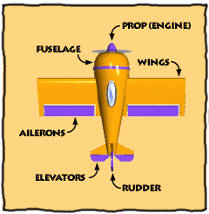
AIRPLANE PARTS
Notes:
The most important part is the wing – remember, this is how the airplane generates lift. What does it take to generate lift again? Motion!
The prop and engine are necessary to get the airplane moving through the air so the wings can do their job and create lift.
The fuselage is where you go! That’s the body of the airplane – where the pilot, passengers and baggage ride.
Ailerons, elevators and rudder are control surfaces. These are how the pilot steers the airplane.

Slide 28
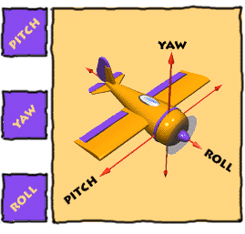
Ailerons Control Roll
The AILERONS control ROLL. On the outer rear edge of each wing, the two ailerons move in opposite directions, up and down, decreasing lift on one wing while increasing it on the other. This causes the airplane to roll to the left or right.

Slide 29
Elevator Controls Pitch
The ELEVATOR controls PITCH. On the horizontal tail surface, the elevator tilts up or down, decreasing or increasing lift on the tail. This tilts the nose of the airplane up and down.

Slide 30
Rudder Controls Yaw
The RUDDER controls YAW. On the vertical tail fin, the rudder swivels from side to side, pushing the tail in a left or right direction. A pilot usually uses the rudder along with the ailerons to turn the airplane.

Slide 31
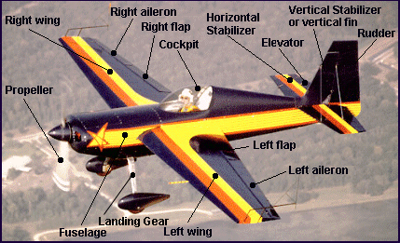
Airplane Parts
Notes:
Why are the wheel pants shaped the way they are?
A vertical stabilizer, or tail fin, keeps the airplane lined up with its direction of motion. Air presses against both its surfaces with equal force when the airplane is moving straight ahead. But if the airplane pivots to the right or left, air pressure increases on one side of the stabilizer and decreases on the other. This imbalance in pressure pushes the tail back into line.
Like the vertical stabilizer, the horizontal stabilizer helps keep the airplane aligned with its direction of motion. If the airplane tilts up or down, air pressure increases on one side of the stabilizer and decreases on the other, pushing it back to its original position. The stabilizer also holds the tail down, counteracting the tendency of the nose to tilt downward--a result of the airplane's center of gravity being forward of the wing's center of lift.
To help make turning easier, an airplane is usually less stable along its roll axis than along its pitch and yaw axes. Several factors help the pilot keep the wings level: the inclined mounting of the wings, the position of the wings above or below the fuselage, the swept-back shape of the wings, and the vertical stabilizer. As an airplane rolls, it tends to slip to the side, changing the direction of relative wind on the wings and tail. These design features help the pilot restore the airplane to its upright position.
Flaps change a wing's curvature, increasing lift. Airplanes use flaps to maintain lift at lower speeds, particularly during takeoff and landing. This allows an airplane to make a slower landing approach and a shorter landing. Flaps also increase drag, which helps slow the airplane and allows a steeper landing approach.

Slide 32
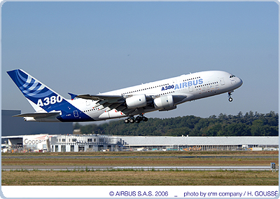
Aircraft Components
An aircraft is an airframe structure on which engines are mounted and is controlled in the air.
Aircraft Components
Fuselage
Wings
Engines
Tail Unit
Landing Gear
Nose (Radome)

Slide 33
Thanks For your Attention
QUESTIONS?
Best Wishes & Good Luck
Eng. Amr el Kady

